Slide 1
Building the
21st Century Developmental State:
Challenges and Possibilities
Peter Evans
Uc Berkeley, Sociology
Watson Institute, Brown University
Presentation for
NUPPAA
Núcleo de Políticas Públicas: Análise e Avaliação
August 1, 2016

Slide 2
The dilemma of
21st Century States
FROM BRAZIL TO CHINA
TO THE U.S. TO THE EU:
STATES ARE UNABLE TO DELIVER THE COLLECTIVE GOODS THAT THEIR CITIZENS WANT AND NEED

Slide 3
The dilemma is self-reinforcing
states’ inability to deliver creates a
Vicious circle
Undermining esprit de corps within states and political legitimacy
Further reducing capacity

Slide 4
THE Capitalism Problem:
21ST CENTURY GLOBAL CAPITALISM
HAS BECOME A REGRESSIVE FORCE: wiping out good jobs,
shrinking necessary services,
undermining general wellbeing.

Slide 5
Capitalism and the State:
Capitalism’s negative effects on society undercut States’ legitimacy
capitalism’s
political and ideological power
Stands in the way of constructing
effective states

Slide 6
Solving the proBlem of
the 21ST CENTURY State
requires confronting the problem of
21ST CENTURYGLOBAL CAPITALISM

Slide 7
The Argument in Brief
I. Capitalism: Current critiques
A. Braudel
B. Piketty
C. Streeck

Slide 8
The Argument in Brief
II. PERspectives on the state: A 40 year evolution.
70’s & 80’s Neoliberalism: the state as obstacle to capitalism’s solution
B 20th Century Developmental State: The state as a solution to capitalism’s problem.
c. 21st Century developmental state: capitalism as the problem for state and society

Slide 9
The Argument in Brief
III. Strategies for building states that can transform capitalism:
Some analytical clues.
A. the essential role of esprit de corps and shared visions. [some clues from the construction of the Confucian-Legalist state in the Qin dynasty via dingxin Zhao]
B. the subtleties of state-society networks [ some hints on the construction of embedded cohesiveness via cheol-sung lee]

Slide 10
Current critiques of Capitalism

Slide 11
Current critiques of Capitalism
Braudel
Capitalism ≠ rule of markets
Braudel (1982:230) capitalism is “the zone of the anti-market, where the great predators roam and the law of the jungle operates” (p. 230).

Slide 12
Current critiques of Capitalism
Piketty
Contra Polanyi’s great transformation, the post WWII “golden age” is the exception that proves the rule.
The rule is the inexorable increase of economic social inequality (and by implication political inequality as well) under the aegis of capitalism.
More positive interpretation = the “golden age” represents an unusual period in which the domination of the state by capital was constrained by other social forces.

Slide 13
Current critiques of Capitalism
Streeck
Capitalism “is a social order and way of life, vitally dependent on uninterrupted progress of private capital accumulation” (2011:1).
As such, capitalism has reached its limit: OECD capitalism is confronted with “a continuous process of gradual decay, protracted but apparently all the more inexorable” (2011:3).

Slide 14
Current critiques of Capitalism
Streeck 2
Worse still:
“Capitalist progress has by now as much as destroyed any agency that could stabilize it by limiting it — the point being that the stability of capitalism as a socio-economic system depends on its Eigendynamik being contained by countervailing forces: by collective interests and institutions subjecting capital accumulation to social checks and balances. (2011:11)

Slide 15
SUMMARIZING:
Current critiques of Capitalism
These critiques build on and reinforce each other.
They culminate in a bleak picture of the capitalist political economy –politically bleak as well as economically bleak.
` Equally important:
None of these three critiques are can be addressed by “development.”
They are focused on the perversions of fully developed capitalism in its Northern European heartland.

Slide 16
PERspectives on the state:
A 40 year evolution

Slide 17
Neoliberalism: state as obstacle to capitalism’s solution
basic Premise:
Based economically on the fantasy syllogism: capitalism = competitive markets;
competitive markets = efficiency and wellbeing
Therefore the state is impediment.
Politically, competitive markets eliminate power whereas the state embodies power, making untrammeled markets synonymous with freedom

Slide 18
neo-liberal ideology: destructive effects
Neo-liberalism is not just destructive in terms of the economic policies it promotes.
The prevalence of Neo-liberal ideology is attractive because of its appropriation of “freedom”and “individual rights.”
This makes it all the more effective at undercutting the construction of positive worldviews that legitimate and stimulate building esprit de corps and the organizational bases of public initiative within the state and in society.

Slide 19
neo-liberal ideology: destructive effects
The result is a “vicious circle:”
Neoliberal ideology and policies undercut the capacity of state officials for coherent capable action.
This in turn shrinks the ability of the state to deliver the goods that
Resulting state failures de-legitimate the state, strengthen the power of capital and further undercut the ability of the state to deliver.

Slide 20
Neoliberalism:
A POLanyian Footnote
. . . Freedom’s utter frustration in fascism is, indeed, the inevitable result of the liberal philosophy, which claims that power and compulsion are evil, that freedom demands their absence from a human community”
(The Great Transformation pp. 265–66).

Slide 21
20th Century Developmental State:
basic Premise:
an institutionally robust, engaged state is an essential enabler of capitalism’s ability to realize its progressive potential.
a classic “state as enabler” view in which the state provides crucial support, enabling private capital to realize its potential as an agent of economic transformation.

Slide 22
20th Century Developmental State:
In my version (Embedded Autonomy, 1995), effective state involvement requires, first of all, capable, coherent public bureaucracies.
These in turn depend on meritocratic recruitment and long-term career rewards that are roughly commensurate with private sector careers.
These are complemented by state-society networks that enable interchange of information and ideas and engagement between the state organizations and social actors.

Slide 23
20th Century Developmental State:
The problem:
The model is founded on the idea that key state actors and key segments of capital can unite around a shared progressive project that acknowledges the contribution of public as well as private actors.
If Streeck is right about modern capitalism, the 20th Century Developmental state is a lost cause.

Slide 24
21st Century developmental state
basic Premise:
Goal is not enabling capitalism to realize its inherently progressive potential.
Goal is capability expansion.
In Sen’s language (1999), enabling people to “lead the kind of lives they value and have reason to value” (p. 18) (or more precisely the expansion of the set of functionings that people have the capability of enjoying).

Slide 25
21st Century developmental state
structural RequirEments:
Structural foundations parallel those of the 20th Century Developmental state – with crucial differences.
20th and 21st Century developmental states both depend on coherent capable state institutions.
Both also depend on state-society networks.
BUT the 21st century state demands more of state-society dimension.

Slide 26
21st Century dev STATE
STATE-Society Networks
The SEN Caveat:
Sen insists that public goals must be arrived at via deliberative means. This “raises the bar” for the construction of state-society networks”
The Ostrom Premise:
Ostrom’s (1996) argues that “Coproduction” is an essential feature of capability-expanding services.
Effective provision depends on the active engagement of those who are supposed to benefit from the services.

Slide 27


SEN + OSTROM:
Can the Model be realized ??
+

Slide 28
21st Century developmental STATE
SeN + Ostrom vs Capitalism???
BASIC PROBLEM:
Constructing the 21st century developmental state requires confronting modern capitalism – ideological and structurally – the “how to” manual for this task still hasn’t been written.

Slide 29
confession:
what must be accomplish is clear, but no one has figured out robust strategies of implementation!

Slide 30
building states that can transform capitalism:
Some analytical clues

Slide 31
1. Lessons from The oldest state
STATE CONSTRUCTION IN QIN DYNASTY CHINA AS AN EXCEPTIONAL EXAMPLE OF THE THE ESSENTIAL ROLE OF ESPRIT DE CORPS AND SHARED VISIONS AMONG ACTORS WITHIN THE STATE .
Dingxin Zhao, The Confucian-Legalist State: A New Theory of Chinese History (Oxford University Press, 2015)

Slide 32
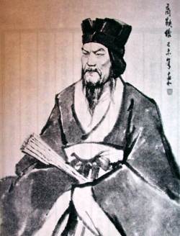
Qin Shang-Yang

Slide 33
The Confucian-Legalist State
In roughly 350 BCE (Qin dynasty) out of the chaos of incessant warfare and the rise and fall of dynasties in China emerged an exceptionally powerful apparatus of governance.
An innovative bureaucratic apparatus was crucially reinforced by the melding of Legalist thinking with Confucian philosophy transformed into a state-supporting ideology.

Slide 34
The Confucian-Legalist State
Confucian-Legalist formulations provided a cultural- ideological matrix that enabled relatively coherent action among thinly stretched set of state cadre.
Enabling them to govern a territory that was far too large and variegated for bureaucratic control structures in themselves to achieve the scope and penetration necessary to control military and economic elites.

Slide 35
Lessons from
The Confucian-Legalist State ???
New ideas can be surprisingly effective tools for discovering public purpose:
Shared, legitimating cultural ideological formulations can have robust and powerful consequences for constructing (or reconstructing) state apparatuses.

Slide 36
Lessons from
The Confucian-Legalist State ???
Obviously we can’t reinvent Confucian-Legalist cultural ideological frames, but this set of ideas appeared to be an unlikely source of political transformation at the time.
Our current cultural-ideological “toolkit” may contain ideas with equal or greater unrealized potential.

Slide 37
2. Dissecting
20th Century transformations in the Global south
20th and 21st century transformations in the global South – from Korea to South African to Brazil – showed that social movement networks can exercise unexpectedly strong political effects.
BUT, apparently similar networks don’t work everywhere and often don’t retain their effects over time.

Slide 38
embedded cohesiveness
New research by Cheol-sung Lee on Brazil, Argentina, Korea and Taiwan provides an intriguing set of hypothesis on what makes progressive networks effective.
Cheol-sung Lee, When Solidarity Works: Labor-Civic Networks and Welfare States in the Market Reform Era Cambridge University Press, 2016)

Slide 39
embedded cohesiveness
Lee argues that the key to network effectiveness depends on whether the networks militant social movements have built combine:
“embeddedness” ( ties to civil society associations)
with
“cohesiveness” (ties to party and state organizations).

Slide 40
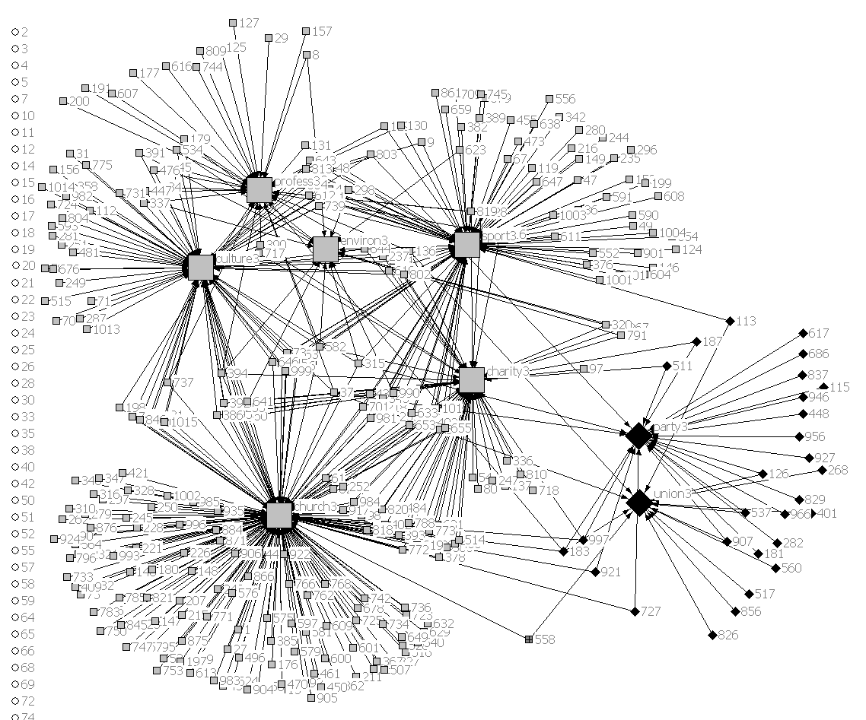
Figure 9-2 Associational Networks based on Comembership Data for Argentina, 2005 (C-S Lee, 2016)

Slide 41
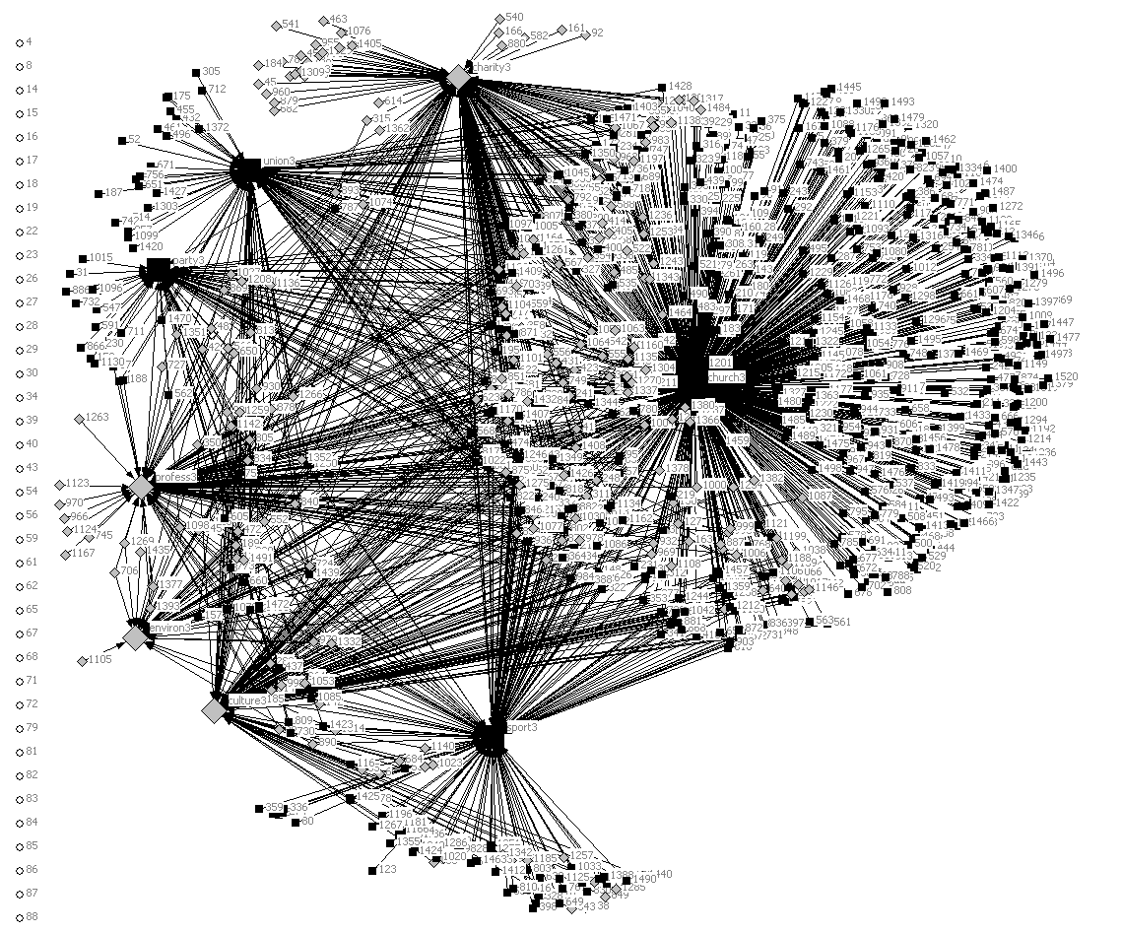
Figure 9-3 Associational Networks based on Co-membership Data for Brazil, 2005 (C-S Lee, 2016)

Slide 42
conclusions

Slide 43
The future of the State and, therefore, the fate of Society, looks bleak
The persistent political and ideological power of capitalism is likely to checkmate strategies for constructing state structures and state-society synergies capable of transforming capitalism.
Absent transformation, the perverse effects of 21st century global capitalism are likely to worsen [risking cataclysmic crises– economic, geopolitical and ecological that would be irreversible.]

Slide 44
Bleak prospects are no excuse for abandoning optimism of the Will
Unexpected increases in state capacity and surprisingly successful social movements have emerged (at least temporarily) in a variety of national contexts in the late 20th and early 21st century, particularly in the Global South. It could happen again.
While capitalism retains political and ideological power, it has lost its legitimacy both at the top (among analysts of the contemporary political economy) and at the bottom (among engaged citizens.)

Slide 45
optimism of the intellect
There are good intellectual reasons for believing that transformation is possible. The analytics of transformation are not a mystery.
Once it is recognized that being a handmaiden to capitalism will neither build state capacity nor enable the state to deliver the public goods that its citizenry requires, the analytics are straightforward.
Goals are nicely specified in the Sen-Ostrom model.
The potential agents – inside the state and in social movements – are clear.
It is only a question of putting the pieces together as coherent, organized, mobilization.

